Slide 1
Life Support Systems Working Together
By Matthew Katterman

Slide 2
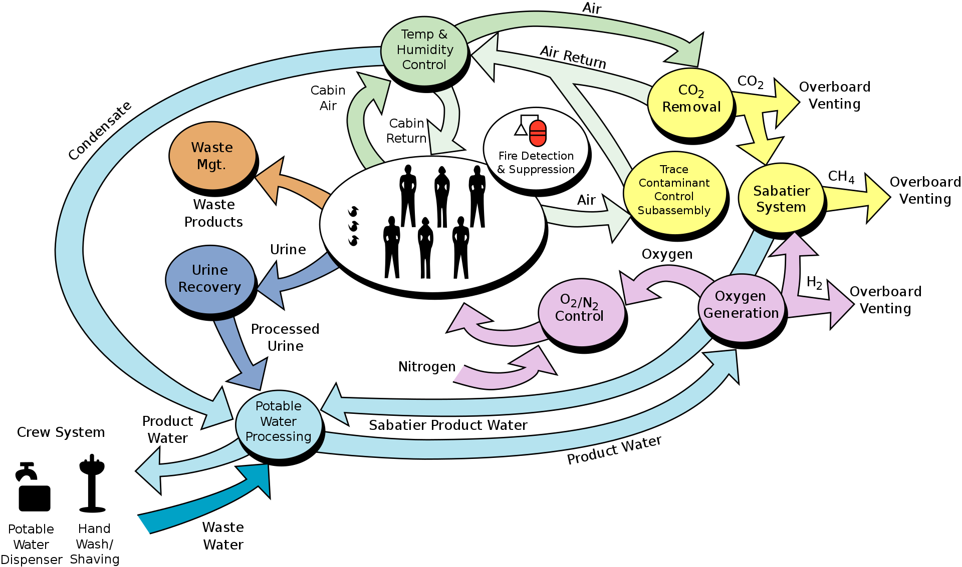
Life Support Systems working together

Slide 3
Describing how life support systems work
Two definitions that describe life support systems
Synergistic – The interaction of elements that when combined produce a total effect that is greater than the sum of the individual elements, contributions, etc.
Synchronous – Occurring at the same time; coinciding in time; simultaneous

Slide 4
Life Support Systems Questions sheet
Life Support Systems
Air Revitalization
Oxygen Generation
Atmospheric Control and Supply
Temperature and Humidity Control
Sabatier System
Water Recovery and Management System
Quick lesson on each of the systems, how they work.
There are a few questions to answer for each lesson. They are written on the sheet. Easy to answer.
Take a few minutes to write out the answers to the questions. Just need a few sentences, not much more.
Will talk about answers as you are writing them out.

Slide 5
Air Revitalization System
Contaminants in cabin air space include carbon dioxide, particulates, dust, volatile organics.
Dust, particles and volatile organics removed by catalytic oxidation followed by chemical adsorption.
Carbon dioxide is removed by sorbent beds which are regenerated.
CO₂ CO₂
CO₂ CO₂
CO₂ CO₂
CO₂ CO₂
Sorbent Beds
CO₂
CO₂
CO₂
CO₂ CO₂
CO₂ CO₂
Sorbents
Catalytic oxidation
Oxidation Adsorption
Chemical Adsorption
Cabin
Air Revitalization
Cabin
Air Revitalization

Slide 6
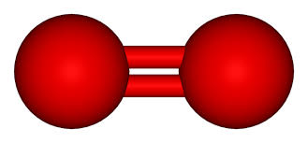
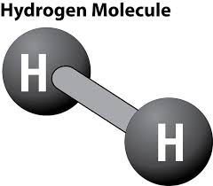
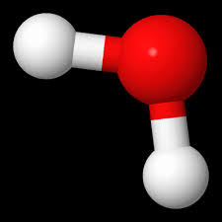
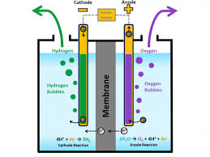
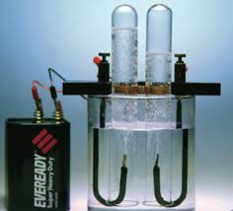
Oxygen Generation System
Oxygen
Water
Water is made up of hydrogen and oxygen atoms.
Creates oxygen from water, done by Electrolysis.
Splits up water into oxygen & hydrogen gases using electricity.
A battery, electrodes and electrolytes are needed to convert water into oxygen and hydrogen gases.
H₂O
O₂ H₂

Slide 7
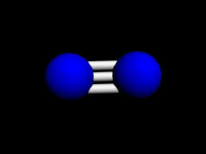

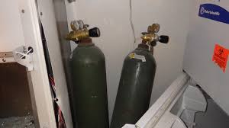
Atmospheric Control and Supply
Oxygen
Nitrogen
What two gases make up most of the air we breathe?
Same proportions of nitrogen and oxygen mixed together in cabin.
78 % Nitrogen, 21 % Oxygen
Nitrogen and oxygen are delivered from pressurized tanks.
The overall cabin pressure is controlled by the amount of Nitrogen provided to it.
N₂ N₂ O₂ N₂
N₂ O₂ N₂ N₂
O₂ N₂ N₂ O₂
N₂ O₂ N₂ N₂
O₂ CO₂
Breathe In Breathe Out

Slide 8
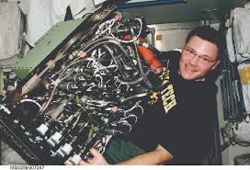
Sabatier System
Uses carbon dioxide recovered from Air Revitalization System.
Uses hydrogen made from the Oxygen Generation System.
Produces water for the Water Recovery system and Oxygen Generation system.
Methane is vented overboard but could be converted into hydrogen.
CO₂ + 4H₂
2H₂O + CH₄
Air Revitalization System
Oxygen Generation System
Water Recovery System
Vented overboard or can make hydrogen

Slide 9
Temperature and Humidity Control
Maintain comfortable temperatures and humidity for the air cabins.
Temperature is controlled by velocity of air flow.
Water vapor is removed from the air and sent to the Water Recovery and Management system.
Air RevitalizationAtmospheric Control & Supply
Cabin Space
Cabin Space Before
Cabin Space After
Air – Water Separator
Velocity

Slide 10
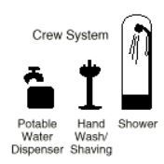
Water Recovery & Management System
Water is recovered from Temperature and Humidity Control System.
Water is generated by the Sabatier System.
Water is recovered from the urine of astronauts.
Water is recovered from baths, cleaning, hygiene activities.
Drinking
Water Recovery System
Oxygen Generation System
Hydrogen
Humidity Control System
Urine Recovery
Baths, Hygiene
Sabatier System

